Slide 1
TASK # 1 ESTIMATION OF WATER LOSSES AND EFFICIENCY OF AN IRRIGATION SYSTEM
Aleksandar Komatina

Slide 2
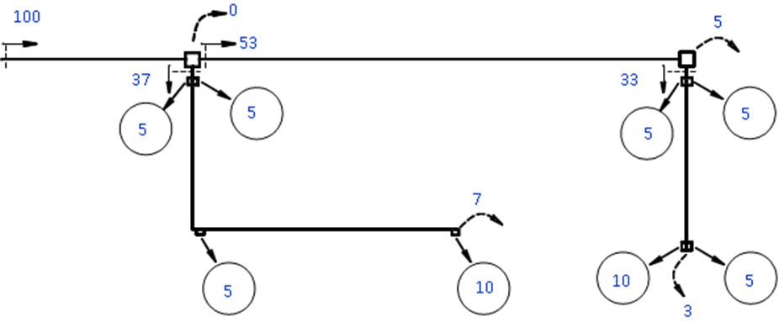

Slide 3
The technical losses ΔV
ΔV = V_{dir} – V_{del} – ΣU, m³
The operational losses ΔOp
ΔOp = S = V_{del} – V_{av}, m³

Slide 5
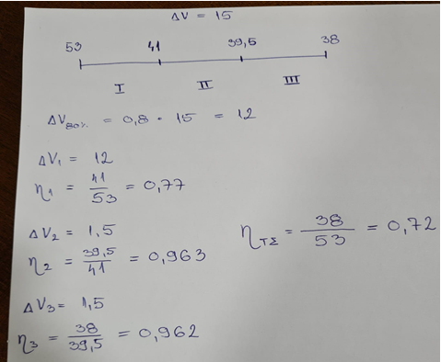
Estimation of Potential Water Savings

Slide 6
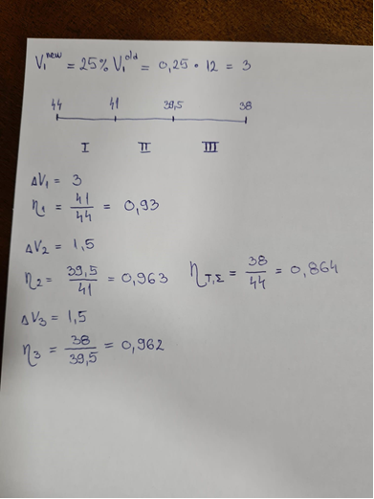

Slide 7
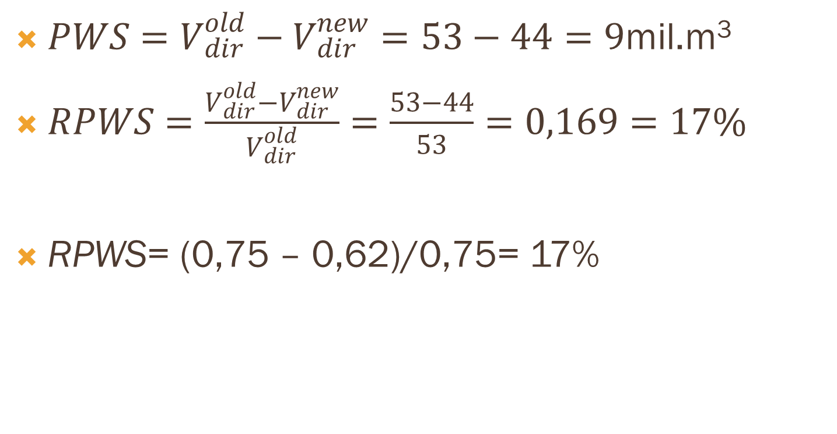
Losses and Technical Efficiencies of the Canal Subsections after Rehabilitation
$PWS=V_{dir}^{old}−V_{dir}^{new}=53−44=9$mil.m³
$RPWS=\frac{V_{dir}^{old}−V_{dir}^{new}}{V_{dir}^{old}}=\frac{53−44}{53}=0,169=17\%$
RPWS= (0,75 – 0,62)/0,75= 17%

Slide 8
CONCLUSION
If the PWS have to be estimated on the level of the entire IS, the value of RPWS will be different. The PWSfor the entire IS arePWS = 9. While calculating RPWS, we should take into account that the overall consumption of the entire IS decreases by 9 units, thus it becomes = 100 – 9 = 91. (or 9 % RPWS for entire IS)

